Slide 1

To Default or Not to Default: An Analytical Approach to Predict Default Cases
Group project
MIS 64037/74037
Tammy Liu, Tongxiang Lu, and Asher John

Slide 2

Introduction
Evolution of Banking Industry
Upheavals in the industry in last two decades
Collapse of major banks
Challenges of granting loans
Big data and bank loans

Slide 3

Objectives
Using big data gleaned from real bank
Preparing the data for final analysis
Develop a prediction model to correctly predict default cases
To predict the amount of loss based on those default cases.

Slide 4

The Data
The data comes from an anonymous bank
The data consists of 762 variables and 80,000 observations
No metadata or titles for the variables are available.
Two sets of data
Training set: for training the model
Test set: for testing the model developed on the training data.

Slide 5

Data Preparation and Cleaning
A preparatory analysis of the data was conducted
Outliers and missing values were found.
More than 40,000 observation with missing values.
Decided to delete all the observation
Outliers were identified.
4000 rows with outliers were deleted.

Slide 6
Dimensionality Reduction
The first technique used was to look at the bivariate correlations between the IVs.
Pair of IVs having correlation > .90 were identified
Second variable in the pair was deleted.
Left with 383 IVs
Second technique applied bivariate correlations between IVs and DV.
IVs having a correlation below 0.04 with the DV were deleted.
Final IV count for the model testing 59

Slide 7

The Model
LASSO and PLS were tested
Both models were not better than random guess
Decision Tree, Random Forest, SVM, and Neural Network (NN) models.
NN was selected as the Final Model
NN model was chosen as it has the best ‘Specificity’

Slide 8
Architecture of the Model
Training Data was split into training and testing
Two different NN models were tested
Final model consists one hidden layer with 150 units
The “relu” function for activation
We used “sigmoid function” for classification
The optimizer we used in the model was “adam” and the “binary-crossentropy” loss function

Slide 9
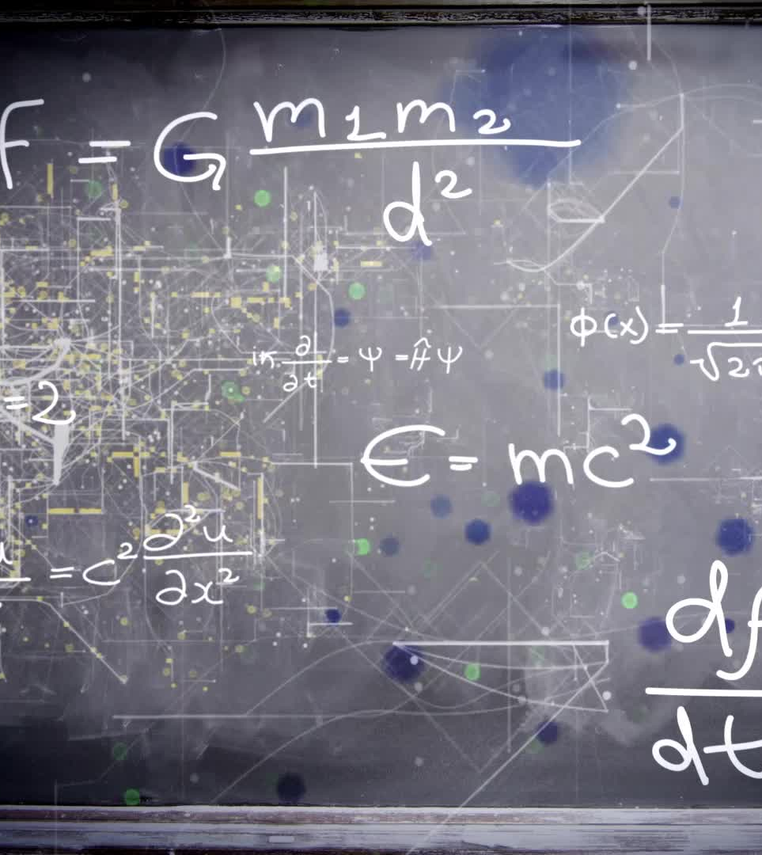
Results
The final model has an MAE of 1.345821;
MSE of 7.247086
Loss of 7.247086;
To test it was applied to the test set extracted from the Training Data
Based on the test data model has an MAE of 1.345821
MSE of 7.247086 and R-Squared of 0.2916.

Slide 10
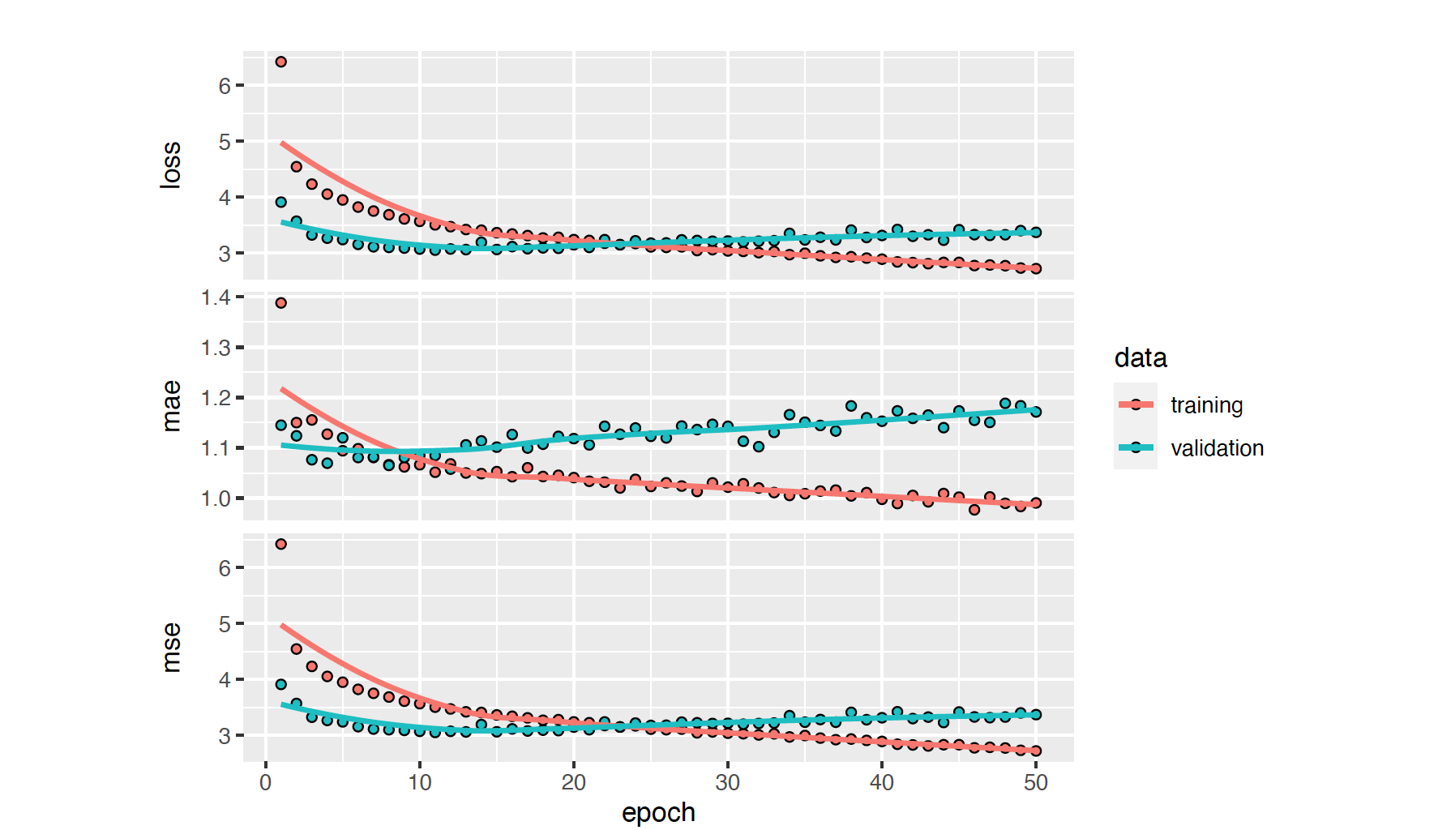
Results of Training & Validation Set

Slide 11

Conclusion & Limitations
Model is good fit and has good predictive power
It has an accuracy of 82%
Limitations include non familiarity with the data
Lack of metadata
Missing values
Thanks.

